Slide 1
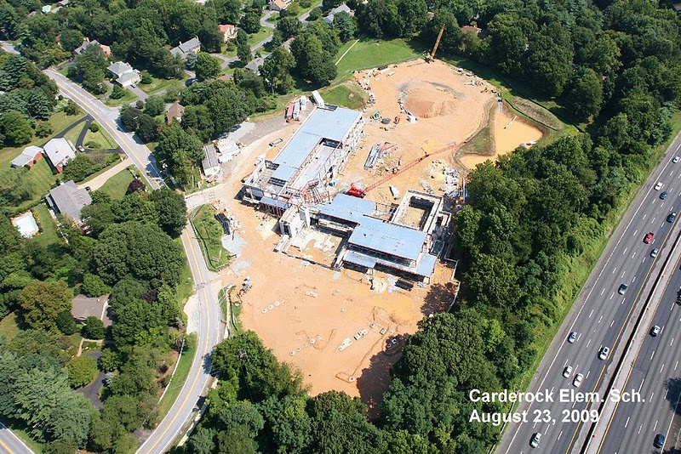
CARDEROCK SPRINGS ELEMENTARY SCHOOL
Bethesda, Maryland
Joe Hirsch | Construction Management | Dr. Magent

Slide 2
Presentation Outline
Project Overview
BIM 3D MEP Coordination
Relocation of Underground Storm Water Retention System (UGS)
Solar Panel Analysis
Structural Analysis
Conclusions
Questions & Answers

Slide 3
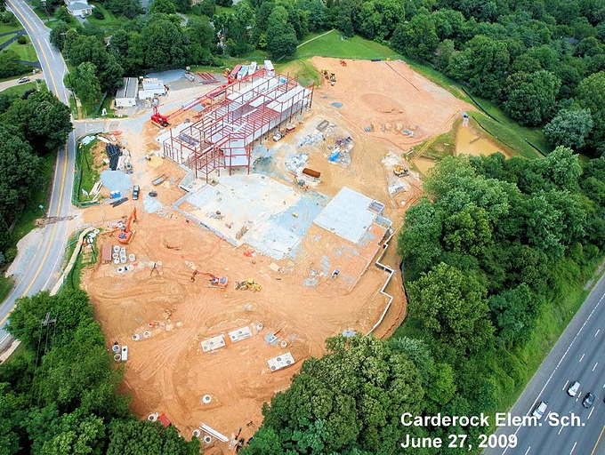

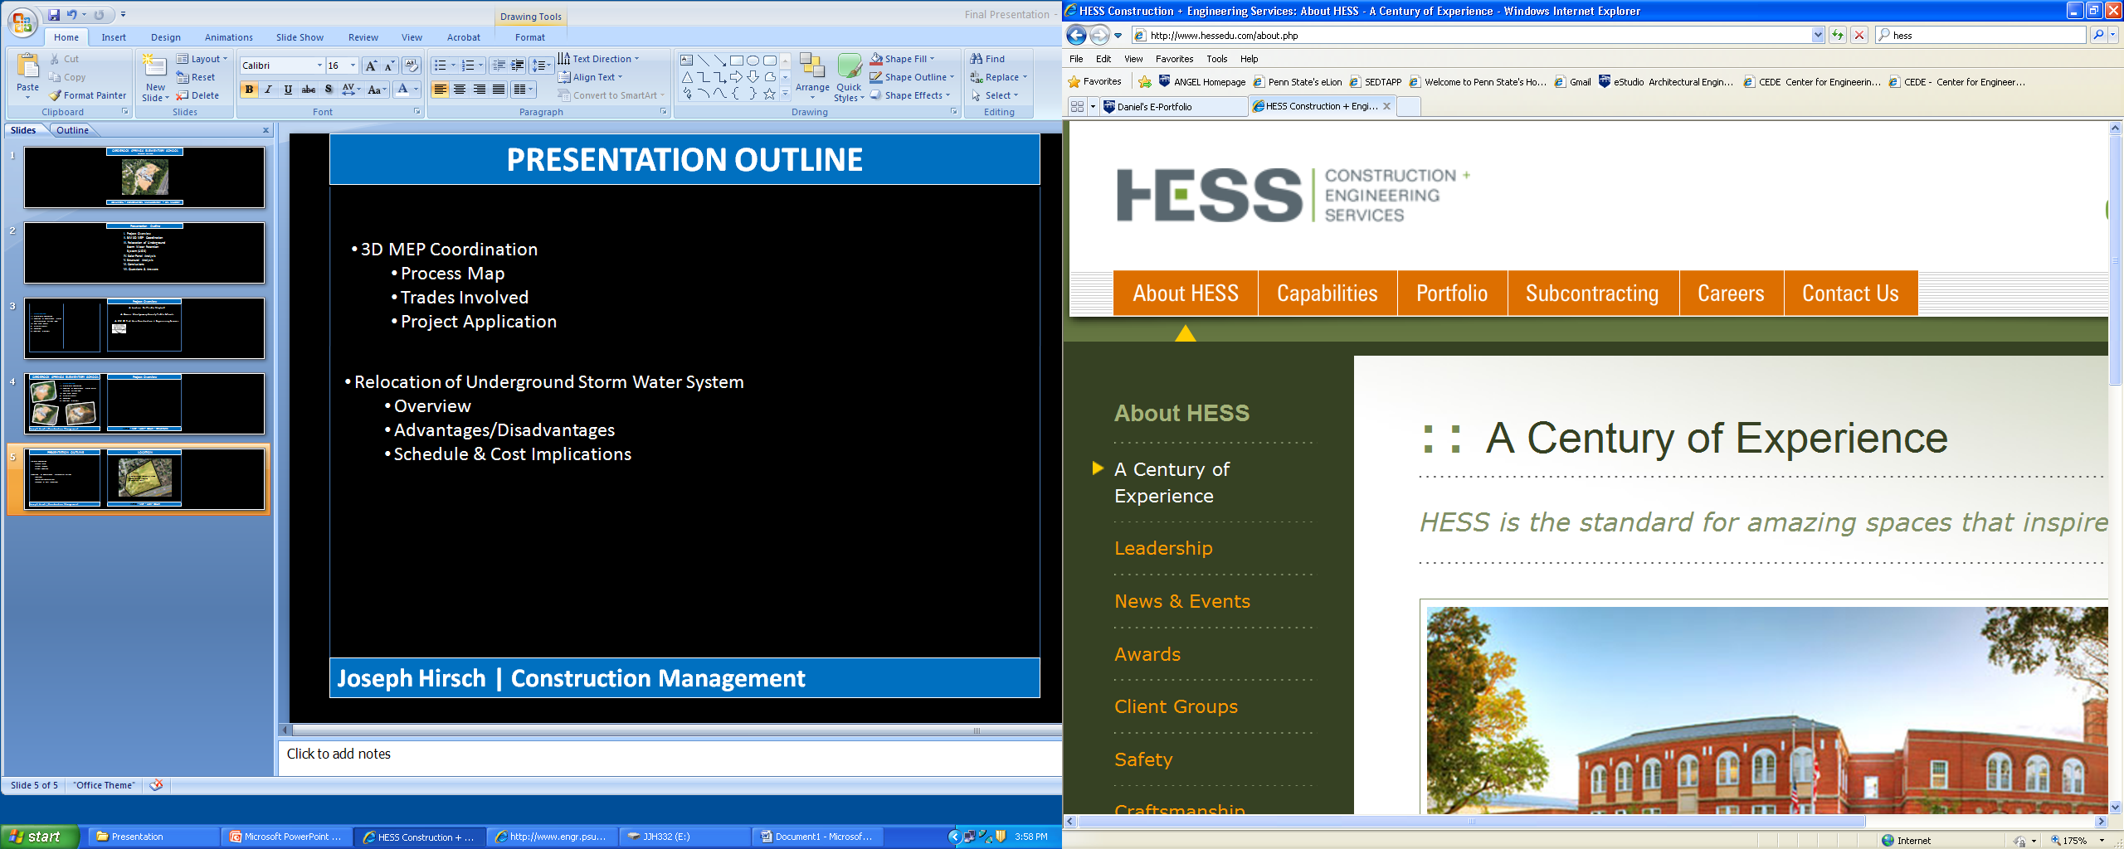
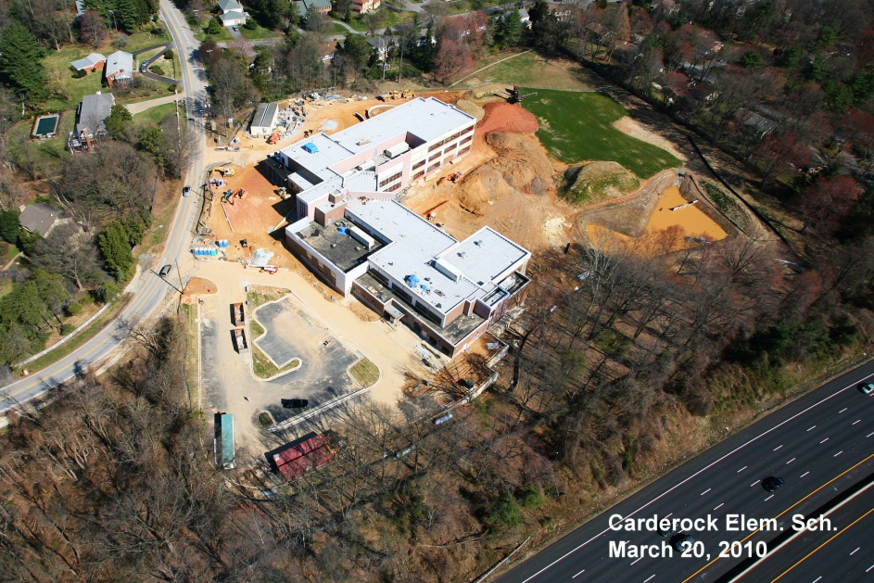

Project Overview
Location: Bethesda, Maryland
Owner: Montgomery County Public Schools
CM @ Risk: Hess Construction + Engineering Services
Project Overview
BIM 3D MEP Coordination
Relocation of Underground Storm Water Retention System (UGS)
Solar Panel Analysis
Structural Analysis
Conclusions
Questions & Answers
Goal: Modernize Carderock Springs Elementary School
New Building is 80,121 ft^²

Slide 4
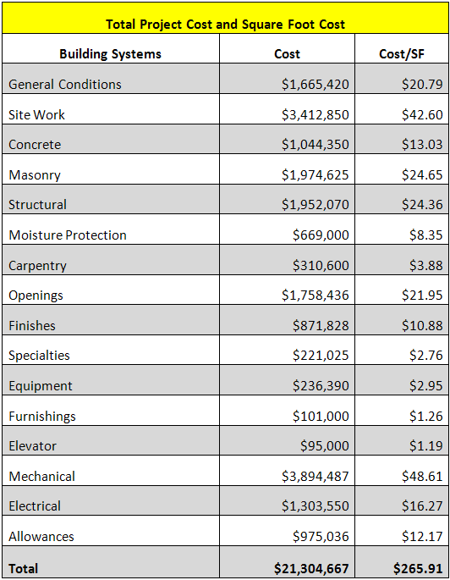
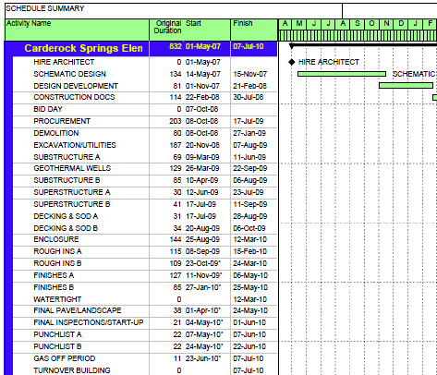
Project Overview
COST AND SCHEDULE
  Approximate cost = $21.3 Million GMP
  Construction Schedule is 20.5 Months
    Demolition Started October 2008
  Owner Receives Building July 7, 2010
    Must complete for start of school year
Project Overview
BIM 3D MEP Coordination
Relocation of Underground Storm Water Retention System (UGS)
Solar Panel Analysis
Structural Analysis
Conclusions
Questions & Answers

Slide 5
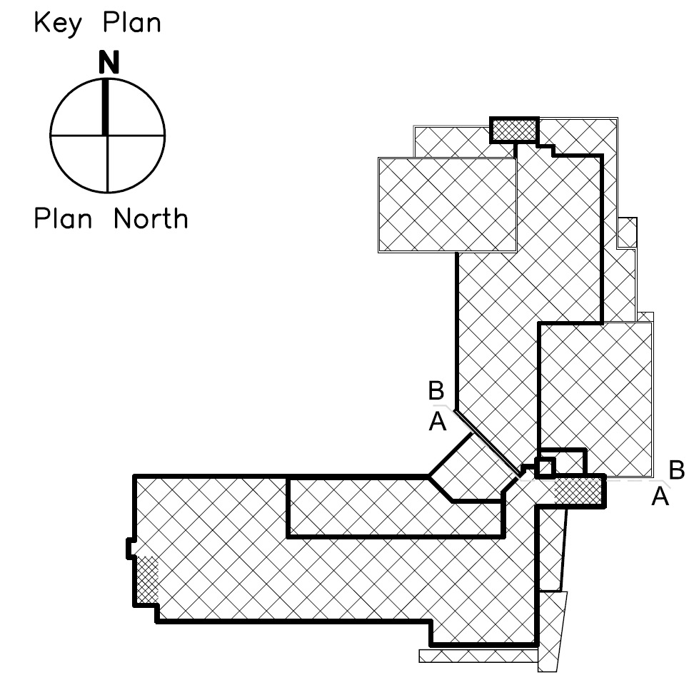

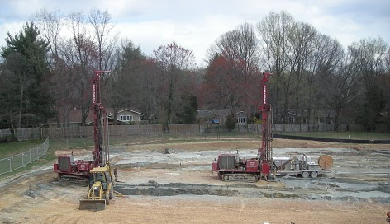
Project Overview
BUILDING SYSTEMS
  Steel Superstructure
  Shallow Footing Substructure (strip and pier footings)
  2-3 Stories
  Geothermal heating & cooling
    120 Wells @ 520’ Deep
  Primarily Masonry Façade w/ CMU backup
  Attempting LEED Silver Certification
Project Overview
BIM 3D MEP Coordination
Relocation of Underground Storm Water Retention System (UGS)
Solar Panel Analysis
Structural Analysis
Conclusions
Questions & Answers
Area B
Area A
Geothermal Drilling and Trenching

Slide 6

Analysis 1 – BIM 3D MEP Coordination
Goals of Analysis
  1. Review Carderock’s 2D Coordination Process
  2. Overview of General Plan for Implementation of 3D
  MEP Coordination @ Carderock
  3. Assess Potential Advantages/Disadvantages of 3D MEP Coordination Process
What is BIM and 3D MEP Coordination?
  “Process in which Clash Detection software is utilized during the coordination process to determine field conflicts by comparing 3D models of building systems.” – PSU CIC
  “The goal is to eliminate the major system conflicts prior to installation.” – PSU CIC
Project Overview
BIM 3D MEP Coordination
Relocation of Underground Storm Water Retention System (UGS)
Solar Panel Analysis
Structural Analysis
Conclusions
Questions & Answers

Slide 7
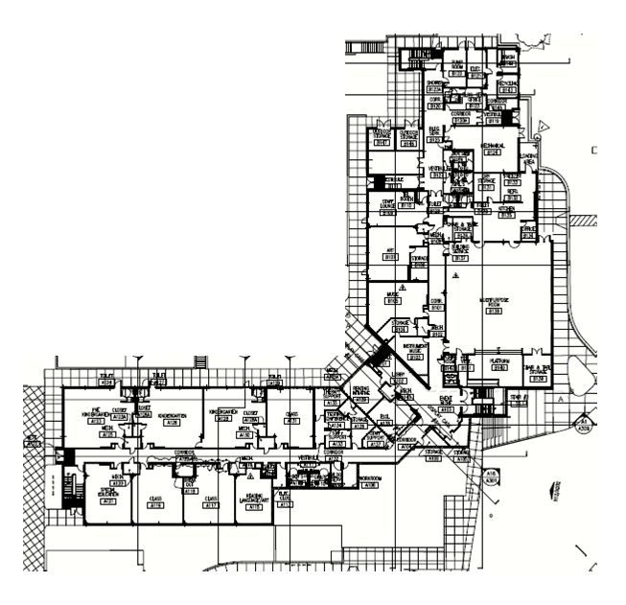
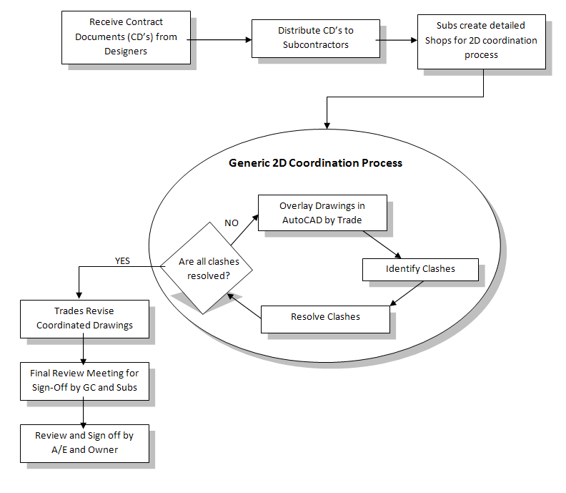
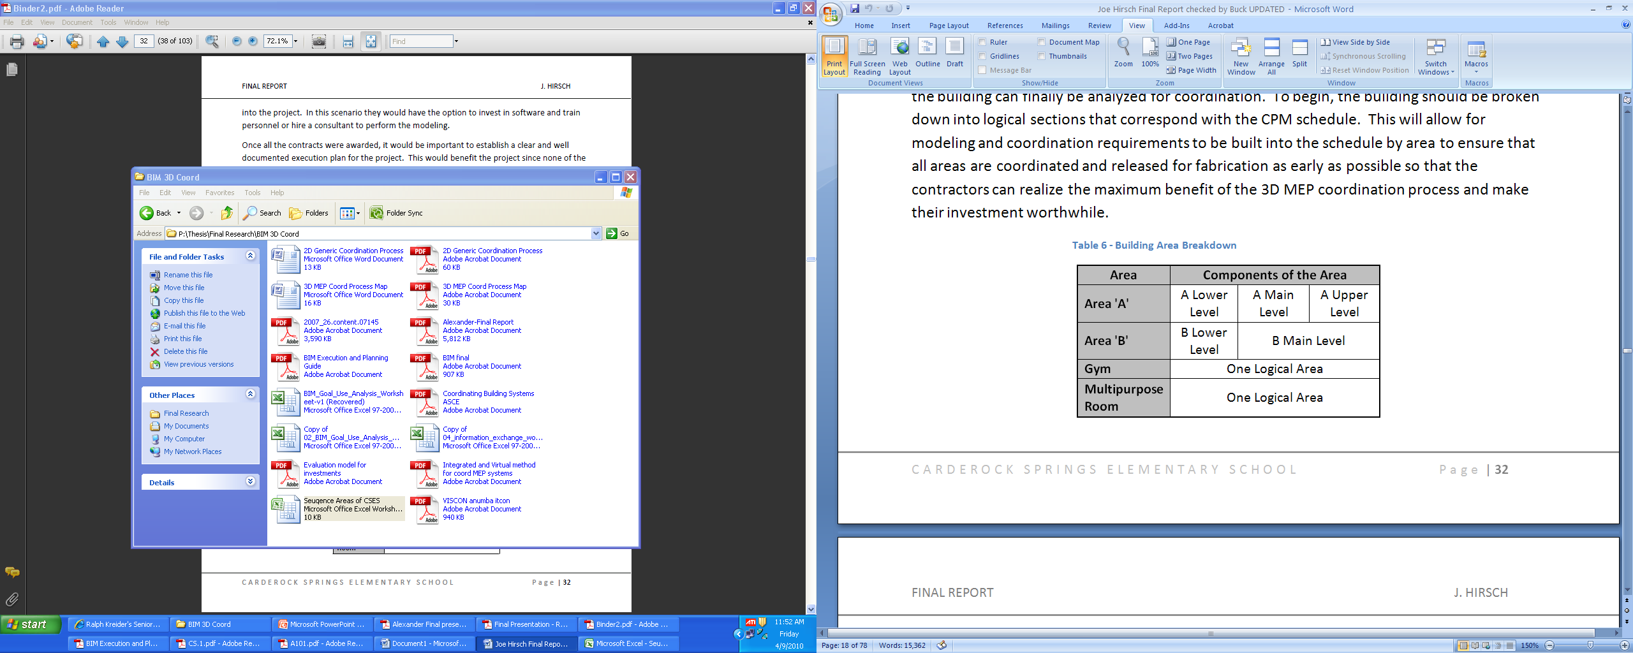
Analysis 1 – BIM 3D MEP Coordination
AREA B
2D Coordination Process @ Carderock
  Separated by Area and Floor Level
  Meeting for each separate area
  Coordination through Intuition and Experience
  3-4 Weeks Coordination Cycle per Area
  Project Manager noted majority of time spent on Change Order Management
  Change Order Process Approximately 1-2 months
Project Overview
BIM 3D MEP Coordination
Relocation of Underground Storm Water Retention System (UGS)
Solar Panel Analysis
Structural Analysis
Conclusions
Questions & Answers
AREA A

Slide 8
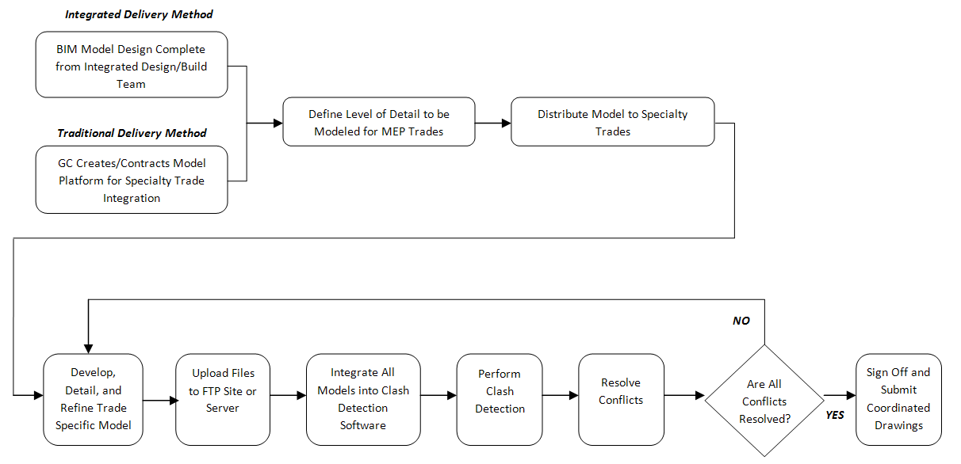
Analysis 1 – BIM 3D MEP Coordination
3D MEP Coordination Process w/ CM @ Risk Delivery
  Prequalify Contractors based on capabilities
  CM Creates Contract Specific 3D Modeling Requirements
    Must define who will model, what to model, level of detail, and software compatibility requirements
    Contractors: Create Models, Upload to FTP,
    CM: Integrate Model, Run Clash Detection, Distribute Reports
    Meetings to crease solutions to conflicts
Project Overview
BIM 3D MEP Coordination
Relocation of Underground Storm Water Retention System (UGS)
Solar Panel Analysis
Structural Analysis
Conclusions
Questions & Answers

Slide 9
Analysis 1 – BIM 3D MEP Coordination
3D MEP Considerations if Implemented @ Carderock
  What trades?
  What are the trades capabilities?
  When to start coordination process?
Trades
  Steel
  Mechanical/HVAC
  Plumbing
  Electrical
  Fire Protection
Project Overview
BIM 3D MEP Coordination
Relocation of Underground Storm Water Retention System (UGS)
Solar Panel Analysis
Structural Analysis
Conclusions
Questions & Answers

Slide 10
Analysis 1 – BIM 3D MEP Coordination
Potential Advantages of 3D MEP Coordination
  Decrease Change Orders & cost increases
  Decrease amount of RFI’s
  Increase Potential for Prefabrication
  Increase Overall Productivity
  Decrease Schedule
  Automated Process
Project Overview
BIM 3D MEP Coordination
Relocation of Underground Storm Water Retention System (UGS)
Solar Panel Analysis
Structural Analysis
Conclusions
Questions & Answers
Potential Disadvantages and Resistance to 3D MEP Coordination
  Learning Curve
  Team Commitment
  Cost of Initial Investment
  Lack of Resources

Slide 11
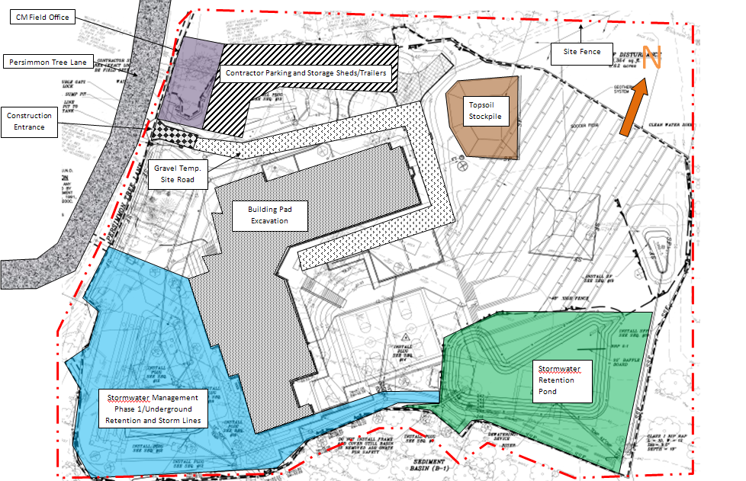
Analysis 2 – Relocation of UGS
Background of Analysis
  Superintendent identified current location restricting to site Utilization in Area B
  Potential for Schedule Acceleration
  Potential for More Parking and on-site Material Storage
Project Overview
BIM 3D MEP Coordination
Relocation of Underground Storm Water Retention System (UGS)
Solar Panel Analysis
Structural Analysis
Conclusions
Questions & Answers

Slide 12
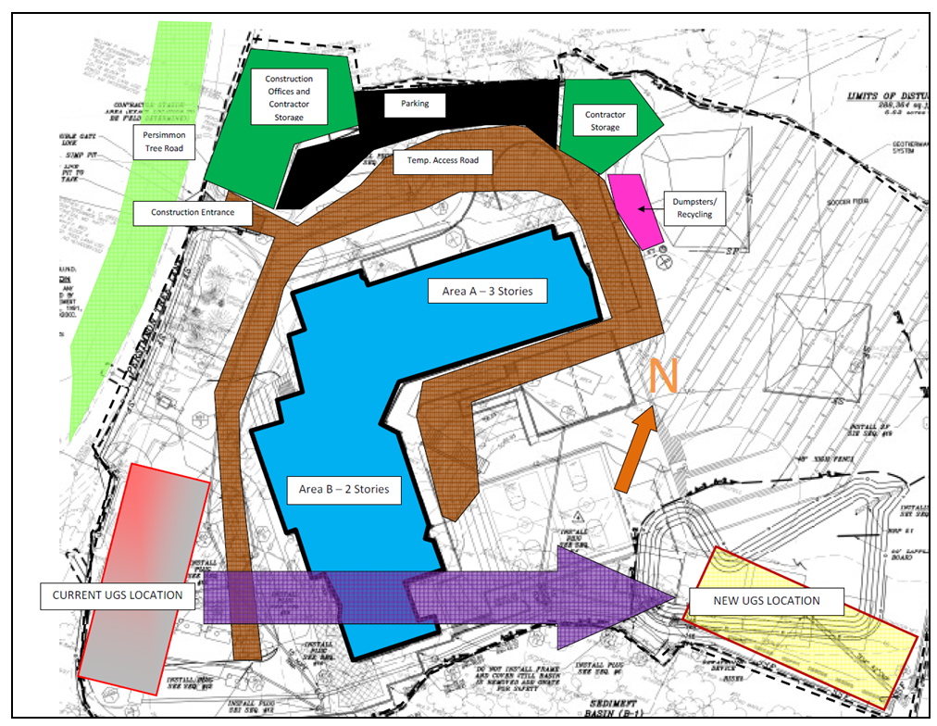
Analysis 2 – Relocation of UGS
New Location Site Analysis
  Current Location at High Site Elevation
    Requires Deeper Elevation for Correct Inverts
    Excavation was approx 25’-30’ deep
  New Location would require only 10’ excavation
Project Overview
BIM 3D MEP Coordination
Relocation of Underground Storm Water Retention System (UGS)
Solar Panel Analysis
Structural Analysis
Conclusions
Questions & Answers

Slide 13
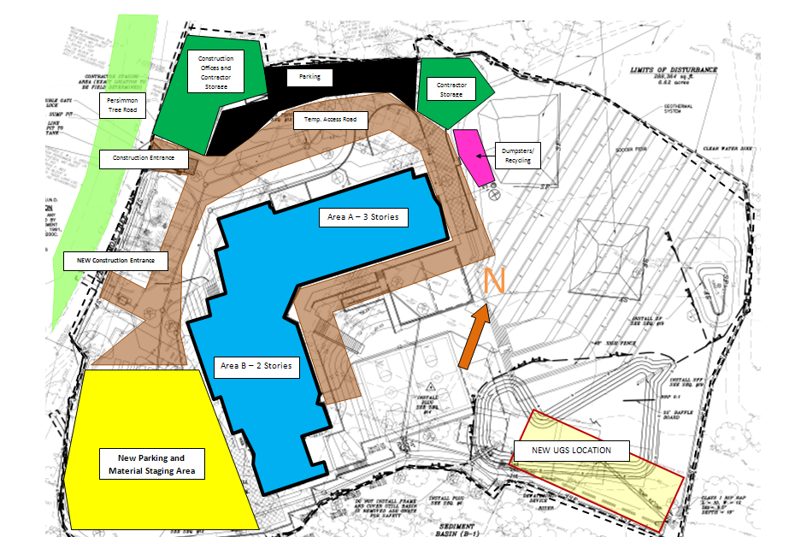
Analysis 2 – Relocation of UGS
Results of New Location
  Save about $5,000 in excavation Costs
  Better Site Utilization Close to Area B
  Ability to Create Additional Parking
Project Overview
BIM 3D MEP Coordination
Relocation of Underground Storm Water Retention System (UGS)
Solar Panel Analysis
Structural Analysis
Conclusions
Questions & Answers

Slide 14
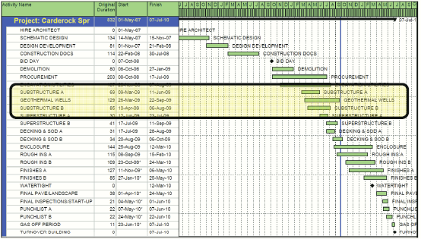
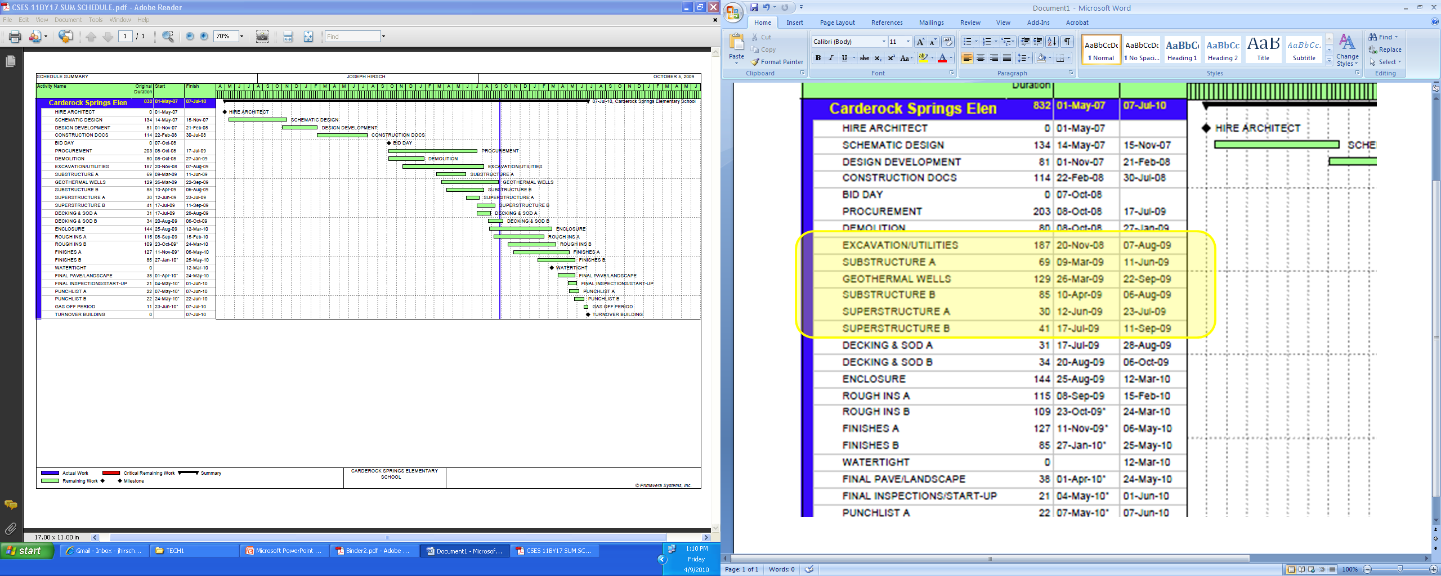
Analysis 2 – Relocation of UGS
Schedule Acceleration Analysis
  By moving UGS, work on Substructure B can begin simultaneously with Substructure A
    Saves about 20-30 Work Days on Critical Path
    General Conditions Savings of about $94,000
    Reduces schedule by about 9.1%
Project Overview
BIM 3D MEP Coordination
Relocation of Underground Storm Water Retention System (UGS)
Solar Panel Analysis
Structural Analysis
Conclusions
Questions & Answers
Management Considerations
  Addition of an Assistant Superintendent
  Materials Procurement & Supply Chain
  Additional Crews Needed
  Quality Control and Concrete Testing

Slide 15
Analysis 2 – Relocation of UGS
Summary of UGS Relocation
  More room for materials and parking
  Opportunity to Decrease Schedule by 9.1% or 20-30 Days
  More Supervision Needed for Quality Control & Coordination
Project Overview
BIM 3D MEP Coordination
Relocation of Underground Storm Water Retention System (UGS)
Solar Panel Analysis
Structural Analysis
Conclusions
Questions & Answers

Slide 16
Analysis 3 – Addition of Solar Panels (Elec. Breadth)
Background of Analysis
  Carderock striving to achieve LEED Silver from USGBC
  MCPS District dedicated to Sustainable Buildings
  Offset electrical Consumption
    Energy Prices are on the Rise
Project Overview
BIM 3D MEP Coordination
Relocation of Underground Storm Water Retention System (UGS)
Solar Panel Analysis
Structural Analysis
Conclusions
Questions & Answers
Goals of Analysis
  Maximize Solar Energy Generation with available Roof Space

Slide 17
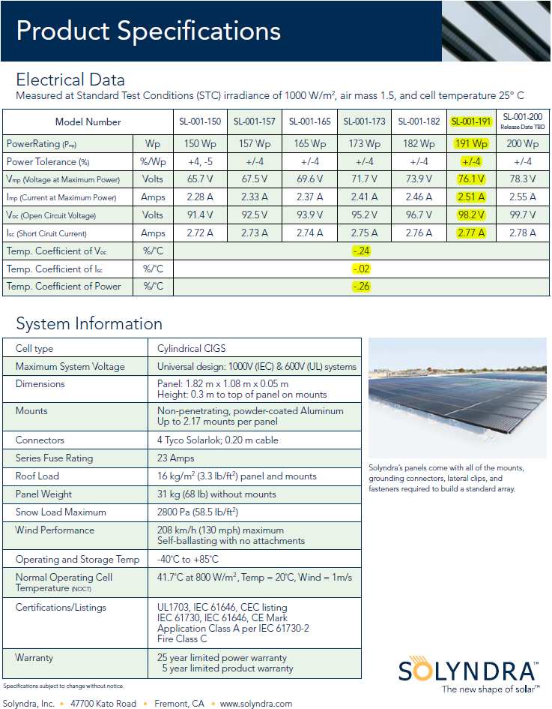
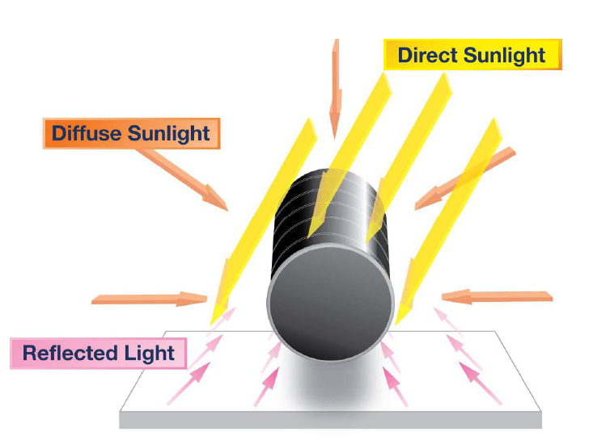
Analysis 3 – Addition of Solar Panels
Product Selection
  Solyndra SL-001-191 Solar Panel
    Cylindrical In Shape – Collects Direct, Indirect, and Reflected Light
    Takes Advantage of the white “cool roof” @ Carderock
    Requires little structural considerations – no protrusions through roof
    Weighs 68lb making installations easier
Project Overview
BIM 3D MEP Coordination
Relocation of Underground Storm Water Retention System (UGS)
Solar Panel Analysis
Structural Analysis
Conclusions
Questions & Answers

Slide 18
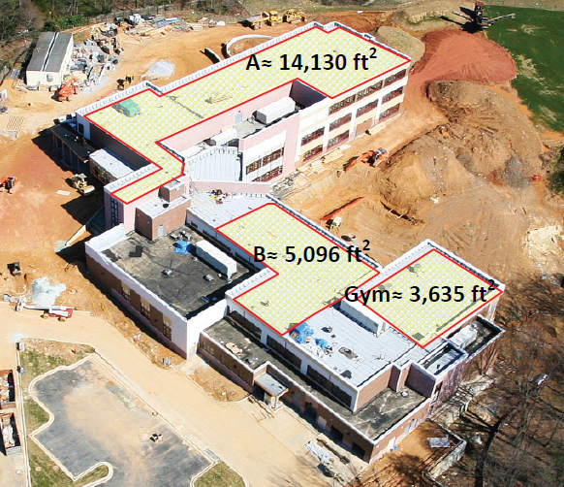

Analysis 3 – Addition of Solar Panels
LEED Design Considerations
  Potentially Can add 2-7 credits in “Optimizing Energy Performance”
  Possibly can push rating to LEED Gold
Design
  Determine Available Roof Space
  Amount of Panels Used is 990 Panels
    660 Panels on A
    330 Between B & Gym
  Three Arrays of 330 Panels will be used
    PVPowered 75 kW inverter for each array
    66 Parallel Strings of 5 Panels
  Amtec Solar Combiner Used to group strings together
    Max Load = 36 strings @ 540 A
    2 Combiners Per Array of 330 Panels
Project Overview
BIM 3D MEP Coordination
Relocation of Underground Storm Water Retention System (UGS)
Solar Panel Analysis
Structural Analysis
Conclusions
Questions & Answers
?
  #2 AWG Conductor used to carry load to Electrical Room
    Rating of 106.6A
    Carried in ½” EMT

Slide 19
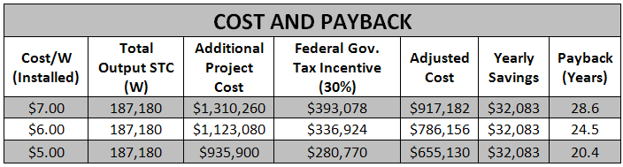
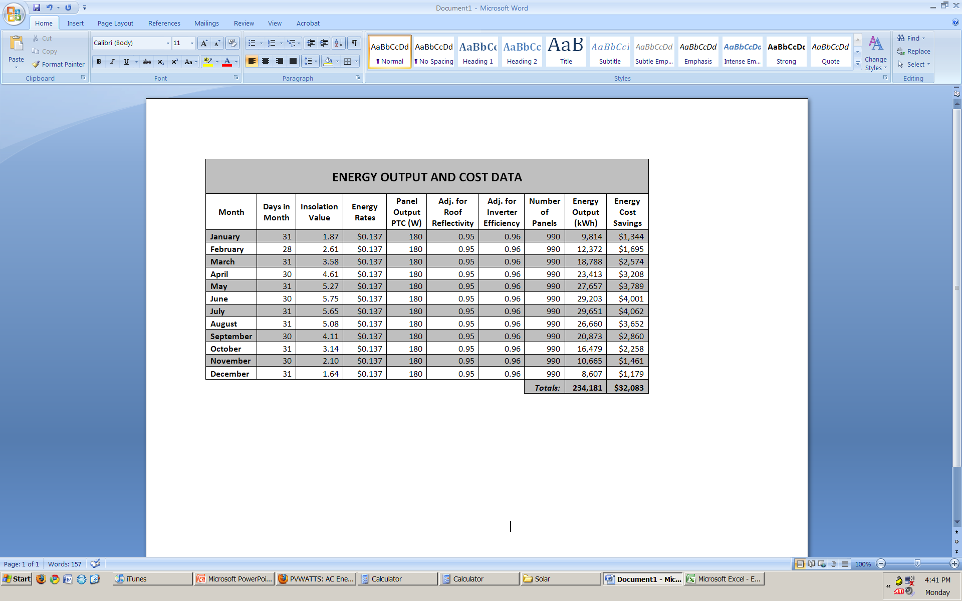
Analysis 3 – Addition of Solar Panels
Output and Payback
Project Overview
BIM 3D MEP Coordination
Relocation of Underground Storm Water Retention System (UGS)
Solar Panel Analysis
Structural Analysis
Conclusions
Questions & Answers
National Center for Education Statistics study in 1998 reported that a public educational facility stands for 42 Years
Recommendation & Conclusions
  Approx. $32,000 saved annually on energy Costs
  Simple Payback between 21-29 Years less than Building lifetime of 42 Years
  Feasible if Budget Allows Initial Investment

Slide 20
Analysis 4 – Structural Change
Background of Analysis
  Gym and Multipurpose Room have Load Bearing Concrete Masonry Unit Walls
    Steel truss rest on the walls
  Multiple Contractors Rely on Each Other
Project Overview
BIM 3D MEP Coordination
Relocation of Underground Storm Water Retention System (UGS)
Solar Panel Analysis
Structural Analysis
Conclusions
Questions & Answers
GYM
Goals of Analysis
  Change system to Steel columns and beams
  Minimize Risks to Critical Path
  Increase Constructability
MPR

Slide 21
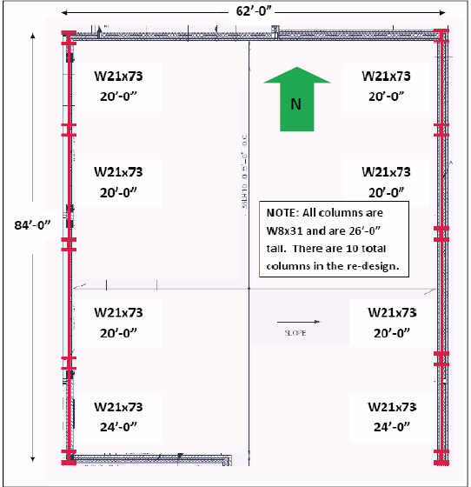
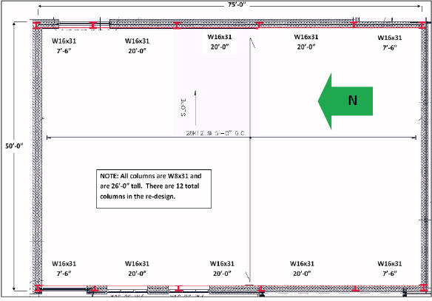
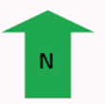
Analysis 4 – Structural Change
Design & Layout
  Load and Resistance Factored Design (LRFD)
Project Overview
BIM 3D MEP Coordination
Relocation of Underground Storm Water Retention System (UGS)
Solar Panel Analysis
Structural Analysis
Conclusions
Questions & Answers
GYM
Multipurpose Room

Slide 22
Analysis 4 – Structural Change
Cost and Schedule Analysis
Project Overview
BIM 3D MEP Coordination
Relocation of Underground Storm Water Retention System (UGS)
Solar Panel Analysis
Structural Analysis
Conclusions
Questions & Answers

Slide 23
CONCLUSIONS
BIM 3D MEP COORDINATION
  Decrease Change Orders
  Increase Productivity
RELOCATE UNDERGROUND STORM RETENTION SYSTEM
  Save 20-30 Days on Critical Path
  $94,000 General Conditions Savings
ADDITION OF SOLAR PHOTOVOLTAIC PANELS
  Offsets $32,000 on Energy Bill Annually
CHANGE STRUCTURAL SYSTEM IN GYM & MPR
  Saves $55,000
  Decrease Schedule by 12 days
Project Overview
BIM 3D MEP Coordination
Relocation of Underground Storm Water Retention System (UGS)
Solar Panel Analysis
Structural Analysis
Conclusions
Questions & Answers

Slide 24

Questions
Acknowledgements
My Parents
All of my friends
Meghan
Buck
Penn State Faculty & Thesis Advisors
Bryan Bailey, Hess Construction + Engineering Services
Dave Gauthier, Hess Construction + Engineering Services
Kristin DiStefano, Hess Construction + Engineering Services
Kassia Aaron, Hess Construction + Engineering Services
Montgomery County Public Schools
BeeryRio Architect + Interiors
Project Overview
BIM 3D MEP Coordination
Relocation of Underground Storm Water Retention System (UGS)
Solar Panel Analysis
Structural Analysis
Conclusions
Questions & Answers

